Slide 1
90% Effort 10% Glory
GISCO Quarterly Meeting, October 20, 2017
Notes:
Overview of Talk
3 projects internships and volunteering
Win-Win-Win Scenarios
3 wins – you, your staff, your customer;
FRCC, organization, student
Real problems for interns
Opportunities for employer-
project management/leadership (rising staff lead interns)
goal clarification
products
Must Know – fundamental skills and concepts
Need to Know – skills and concepts to complete the task
Nice to Know – useful but not required
90%/10% split – 90% skills and knowledge well developed, 10% pushing the edge (examples: language acquisition)

Slide 2
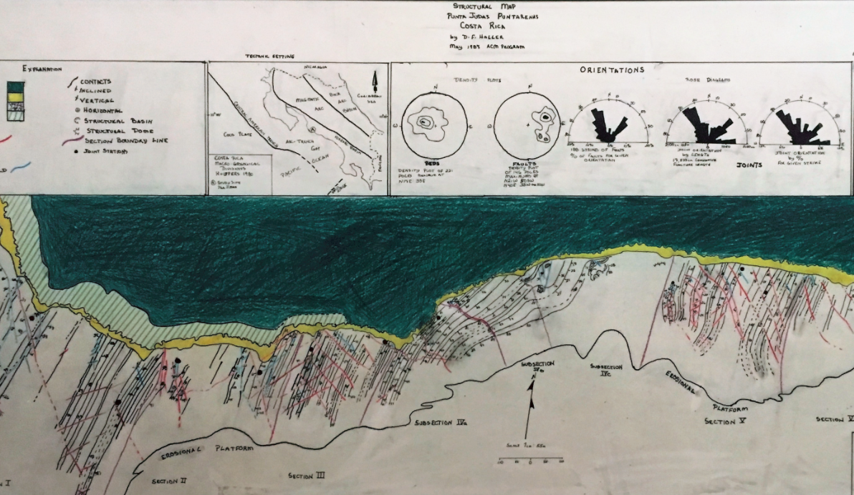
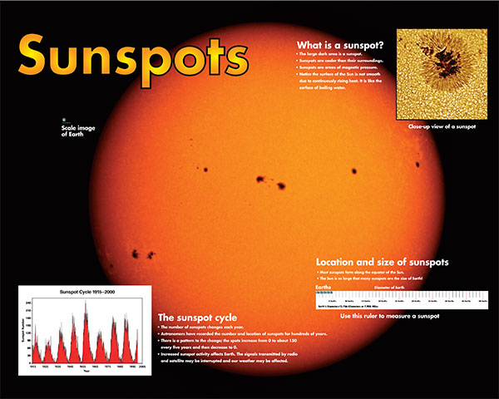
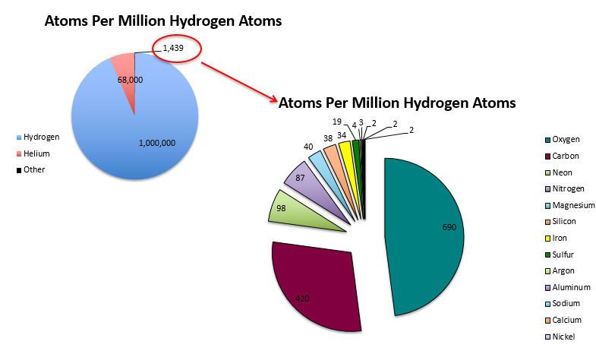
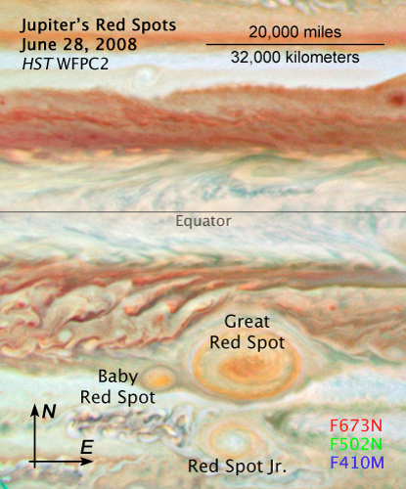
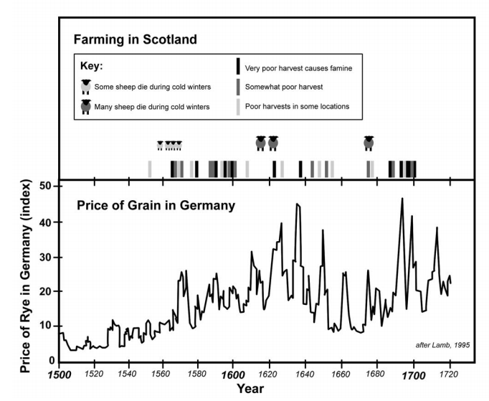
Notes:
Students to collect, interpret, and present data
Subject Matter Experts – broader impacts of research
Professional Development experience
Performed quantitative and qualitative research in the process of improving products and programs
NASA, NIH, NCAR, NREL etc
For profit, non-profit, government clients

Slide 3
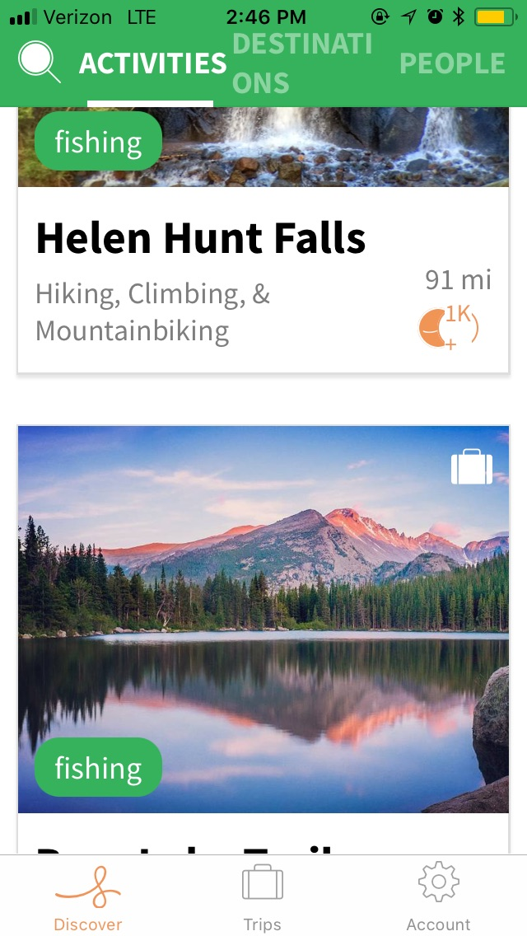
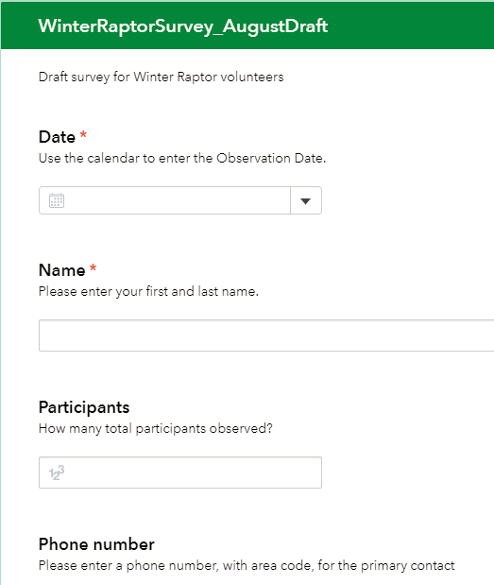
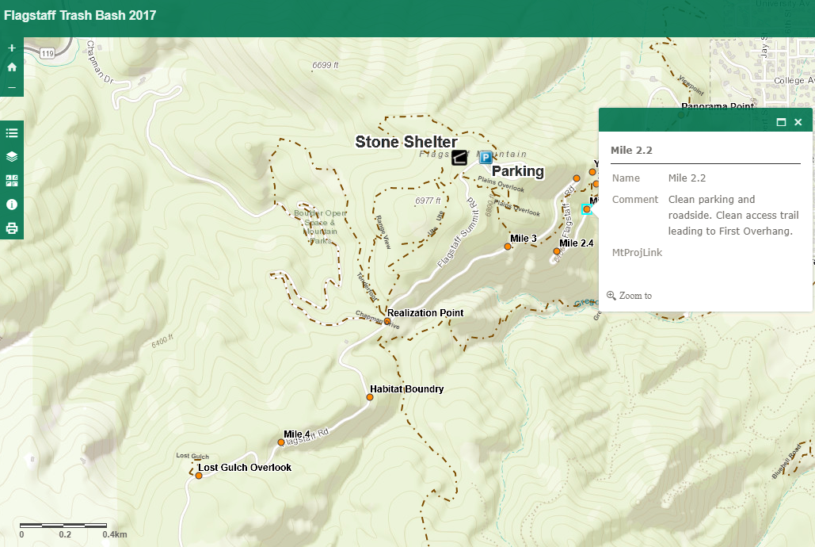
Three Projects
Smartphone Application – Start-up
On-line Survey – Local Government
Paper and Web Map – Community Service
Notes:
Completely different customers
Different goals
Different products

Slide 4
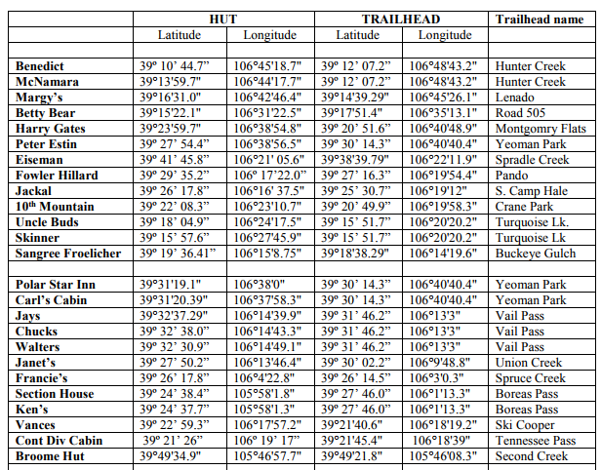
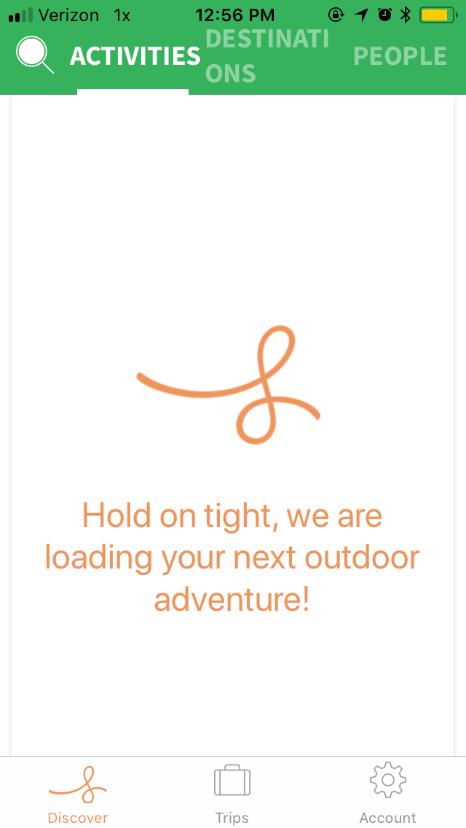
Smartphone Application: LocaWild
Goal: develop database of Instagram images which recommend outdoor recreation by location & activity
Challenges: data sourcing & management, workflow automation, API design
Successes: Python scripts to convert data to state level csv; use of coordinates to source location and images
Next steps: database expansion, API update, additional data, code to remove unnecessary fields
Notes:
Originally creating CSV to load via admin
90% - locating public domain data, reviewing attributes
10% - developing Python scripts
Must know/Need to know – value of GIS data and concepts to creating a phone app that combines location, recreation and images

Slide 5
Raptor Survey: Boulder County
"I can confidently say it’s been a really valuable learning experience for us all, and something that probably would not have happened without the Geospatial Centroid creating the opportunity “ – Boulder County Staff Member
Notes:
Extremely well organized

Slide 6
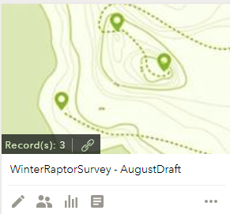
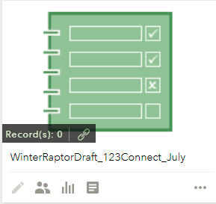
Raptor Survey: Boulder County
Goals: convert paper/pencil forms to online survey
Challenges: ensure ease of use for volunteers & wildlife scientist; source software
Successes: Survey123 vs 123 Connect; well received by volunteers/scientists
Next Steps: convert to web map allowing access to survey using Survey123 Connect
Notes:
90% - understand SME and volunteer audiences – different but just as important; ability to evaluate tools
Program Evaluation – importance of selecting a tool that works for volunteers – Adoption of technology
10% - use of Survey 123 and Survey 123 Connect

Slide 7
Breaking News
ArcGIS for Developers, plus Survey123, plus a grid shapefile
Able to produce a Web App with a link to the survey form

Slide 8
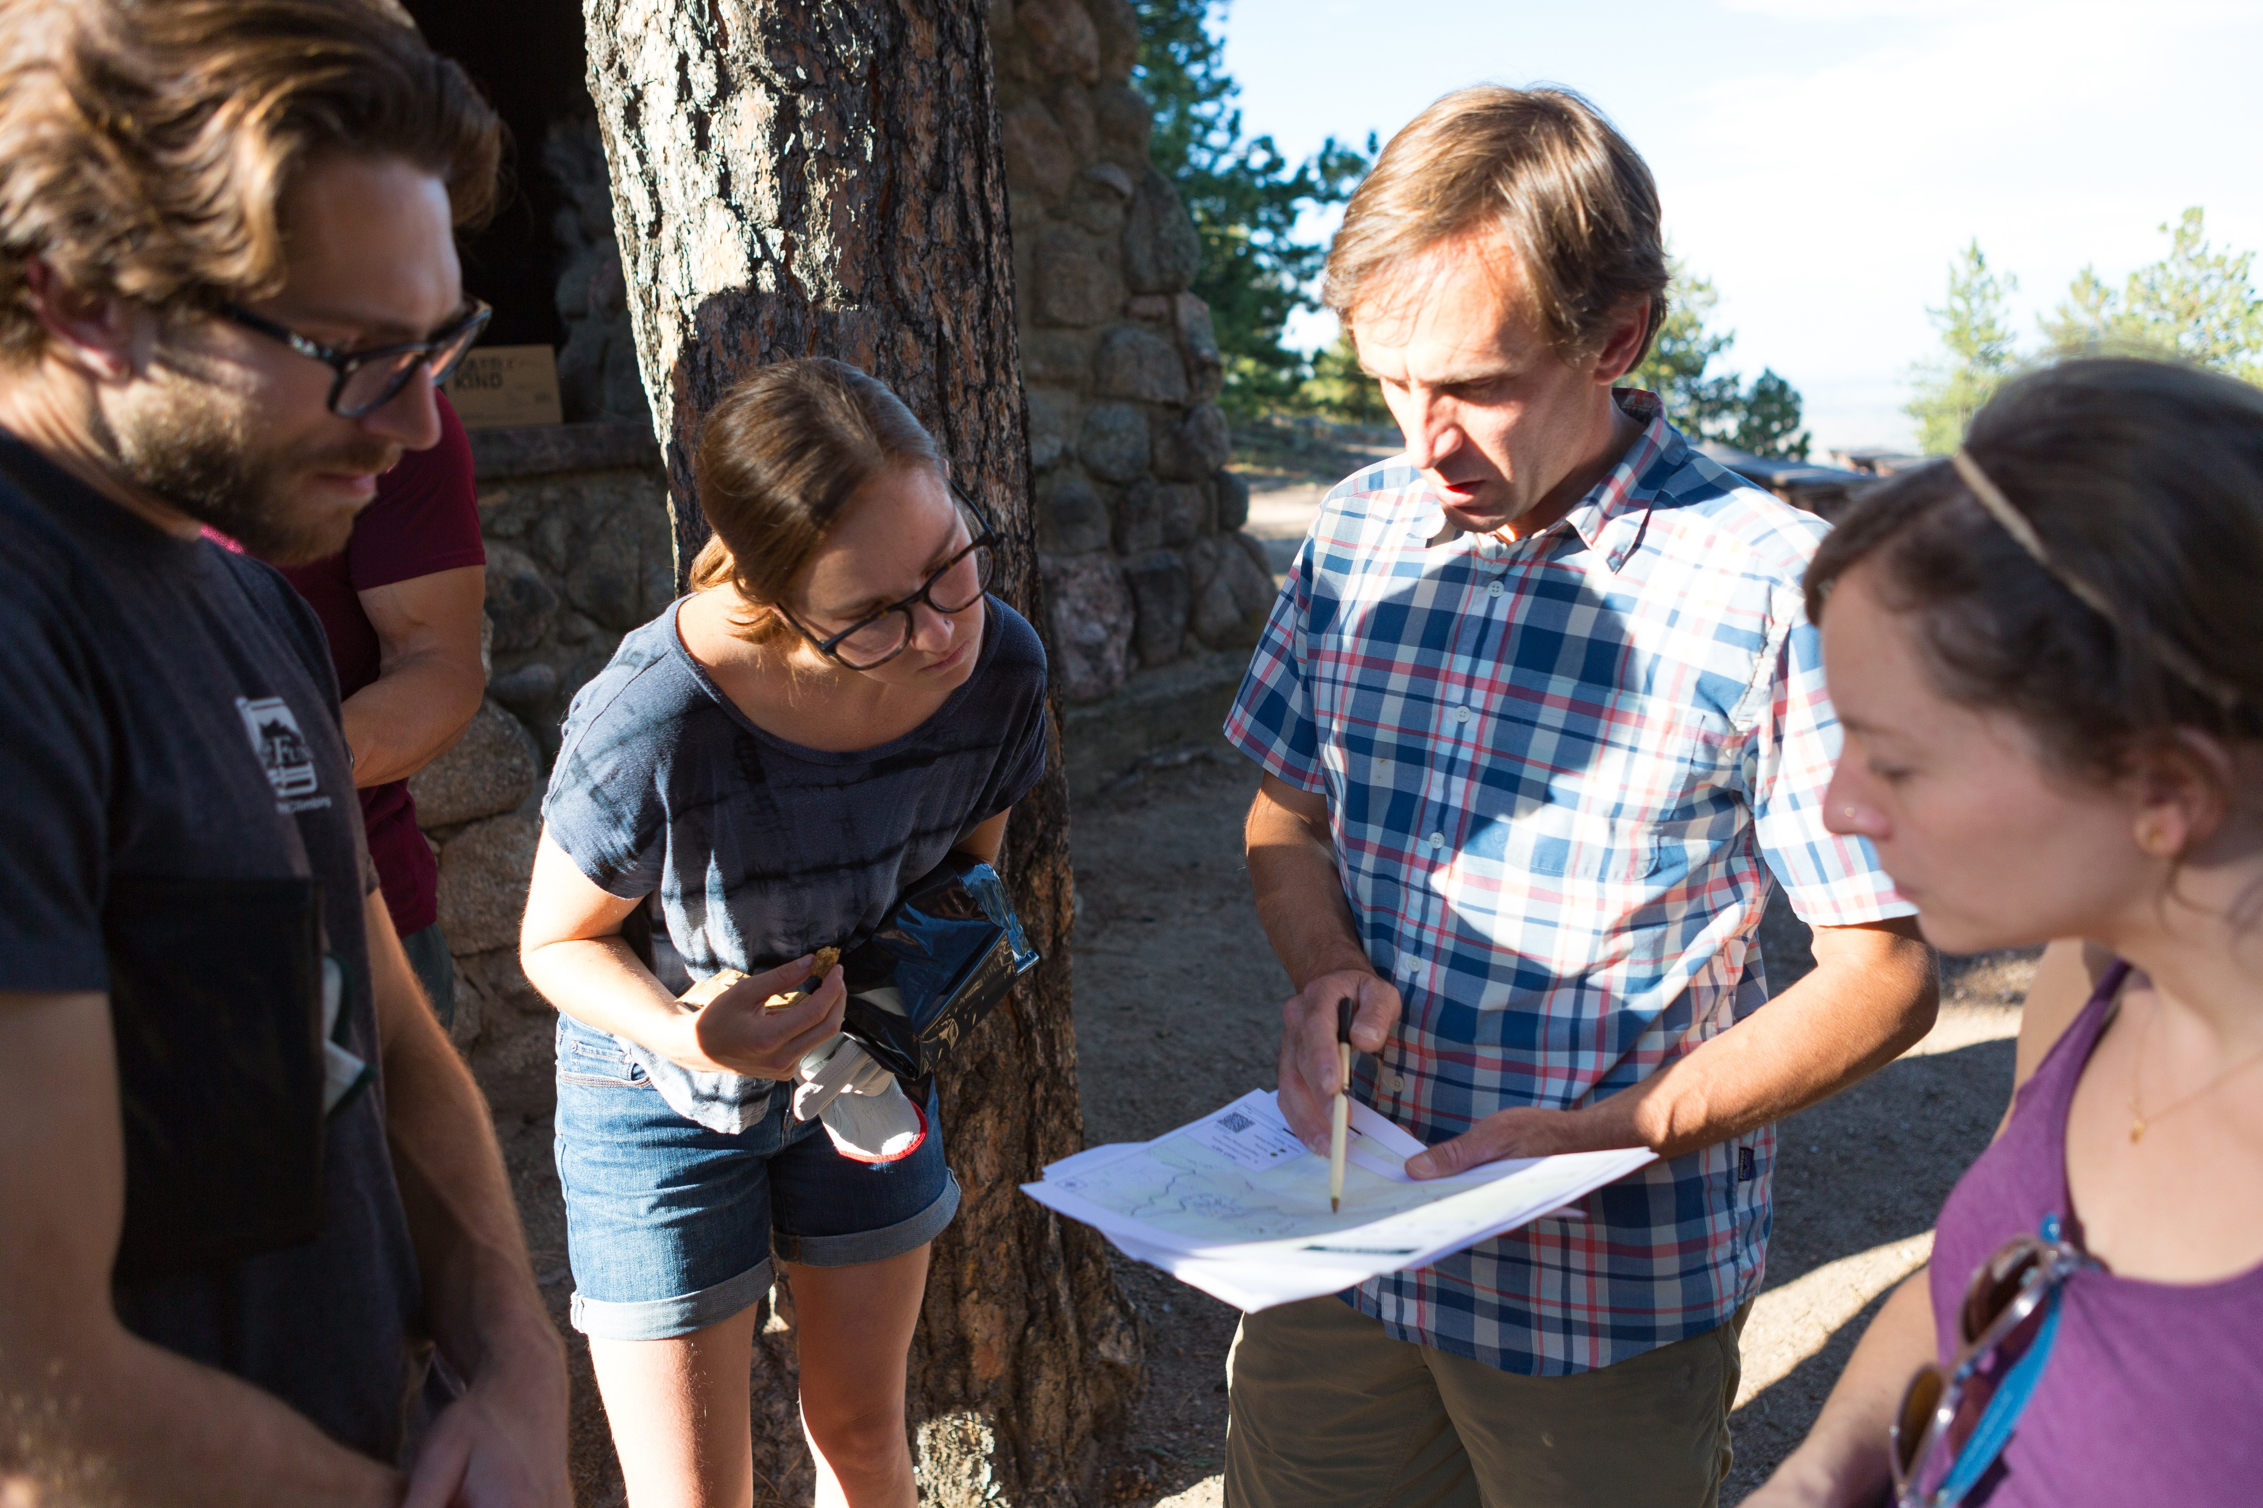
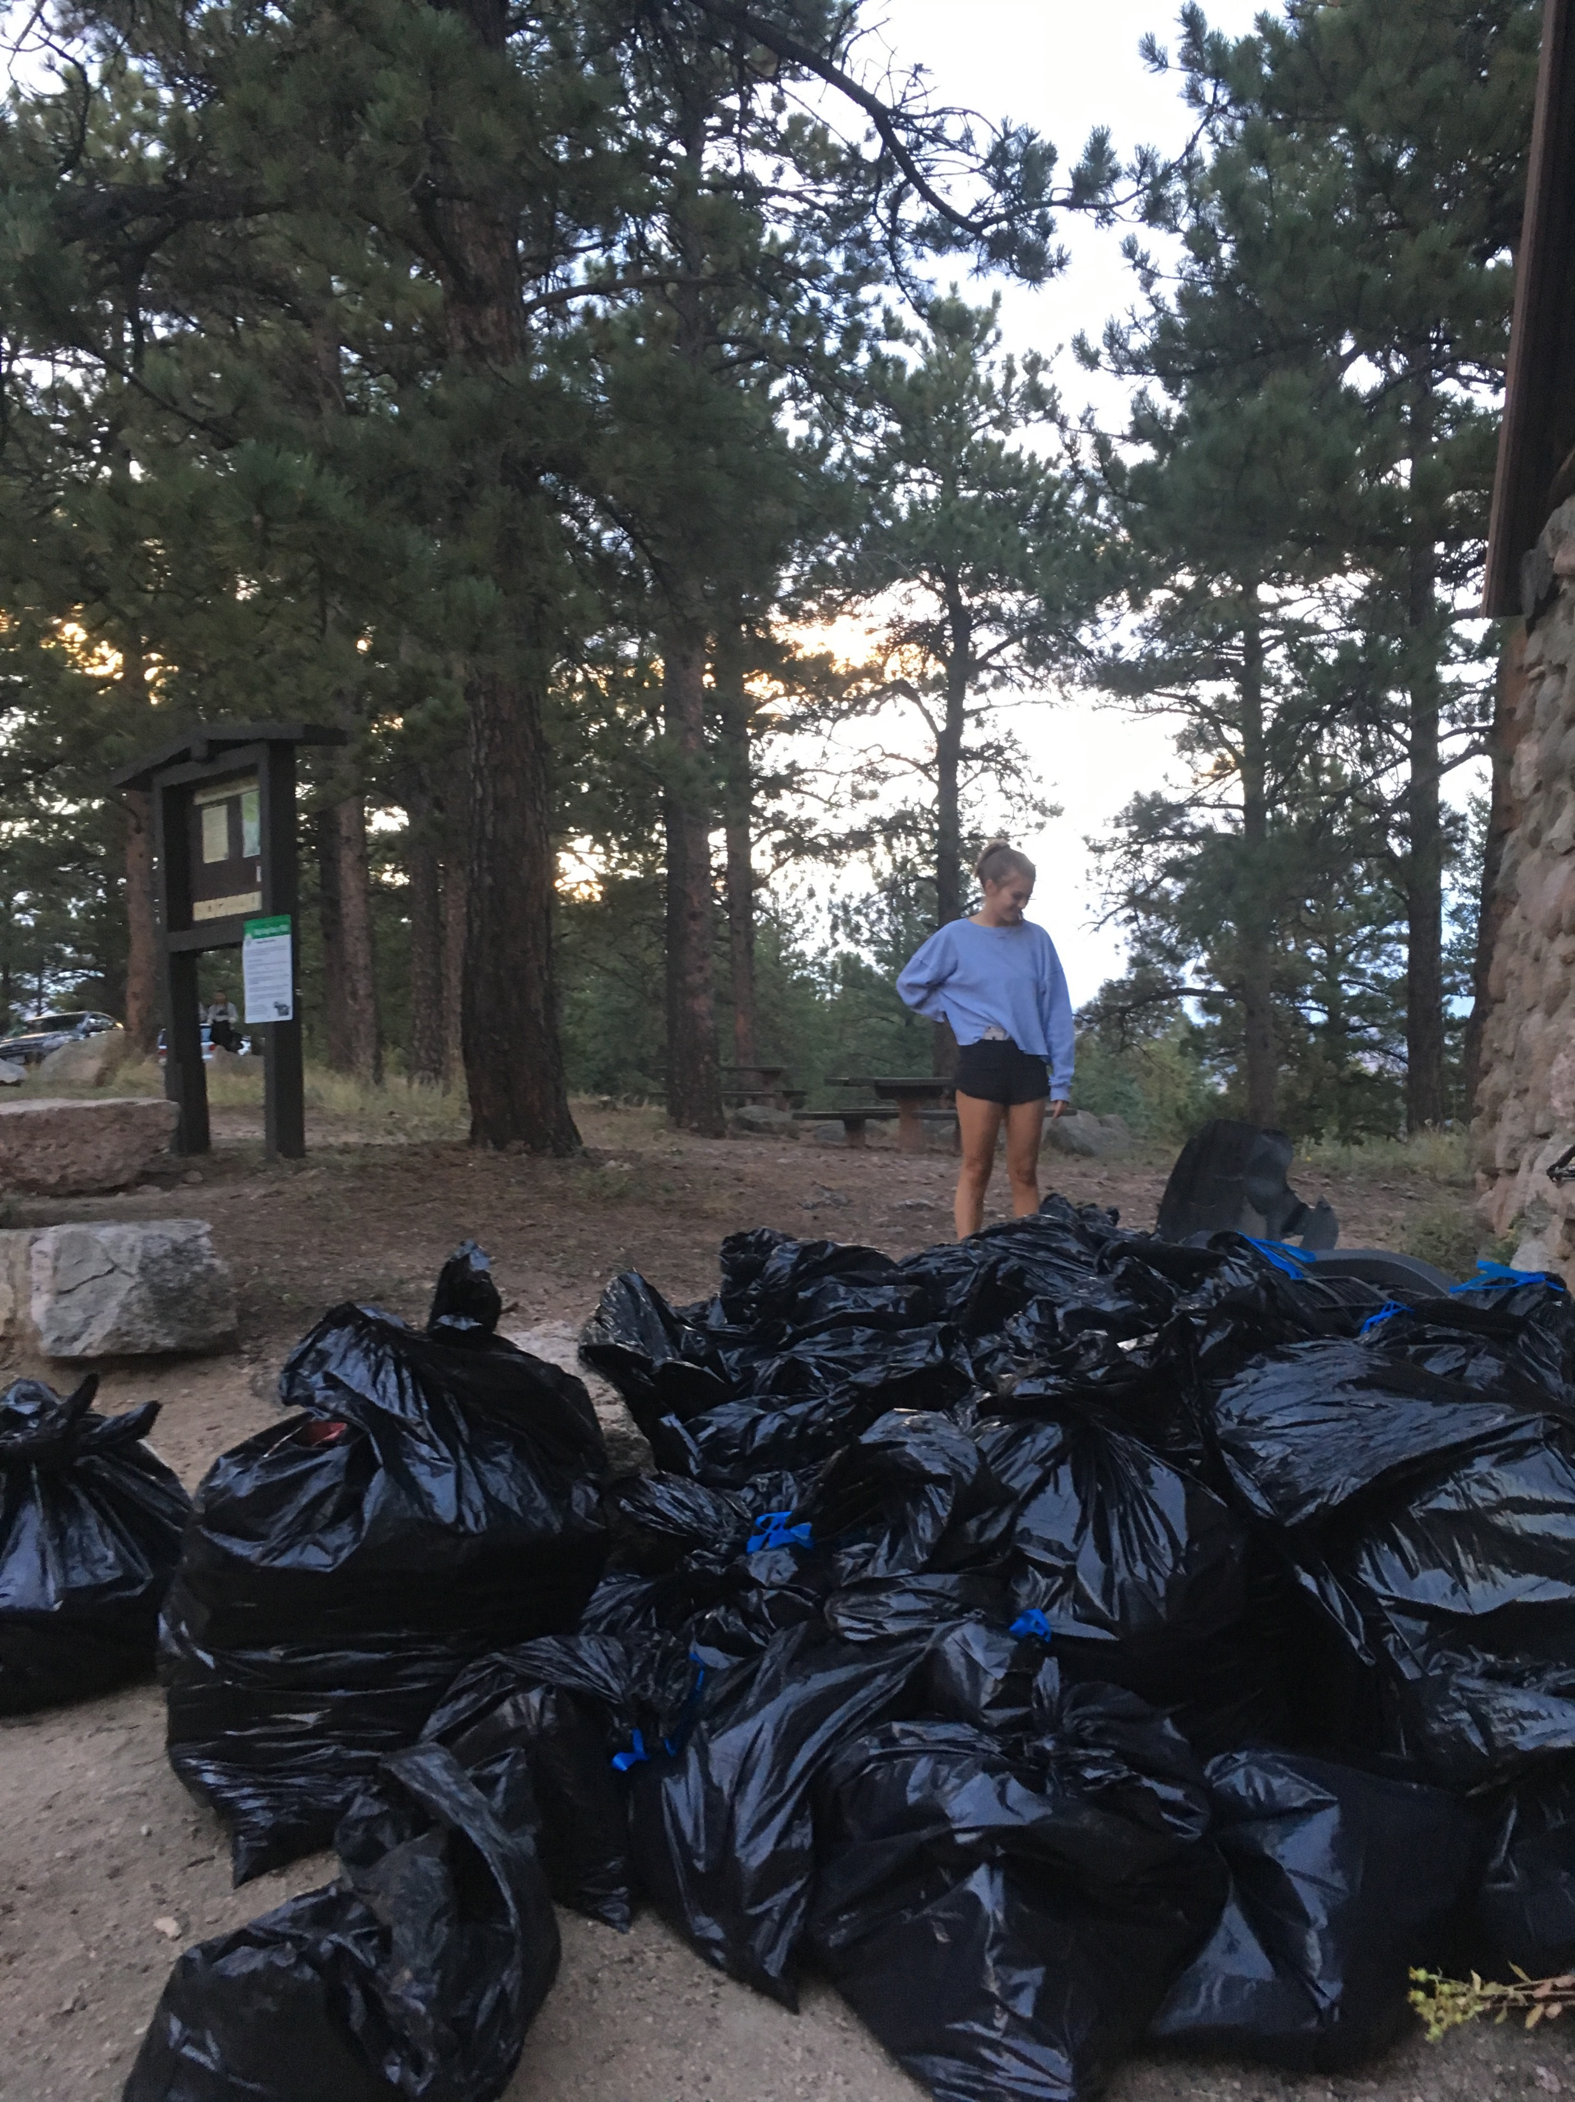
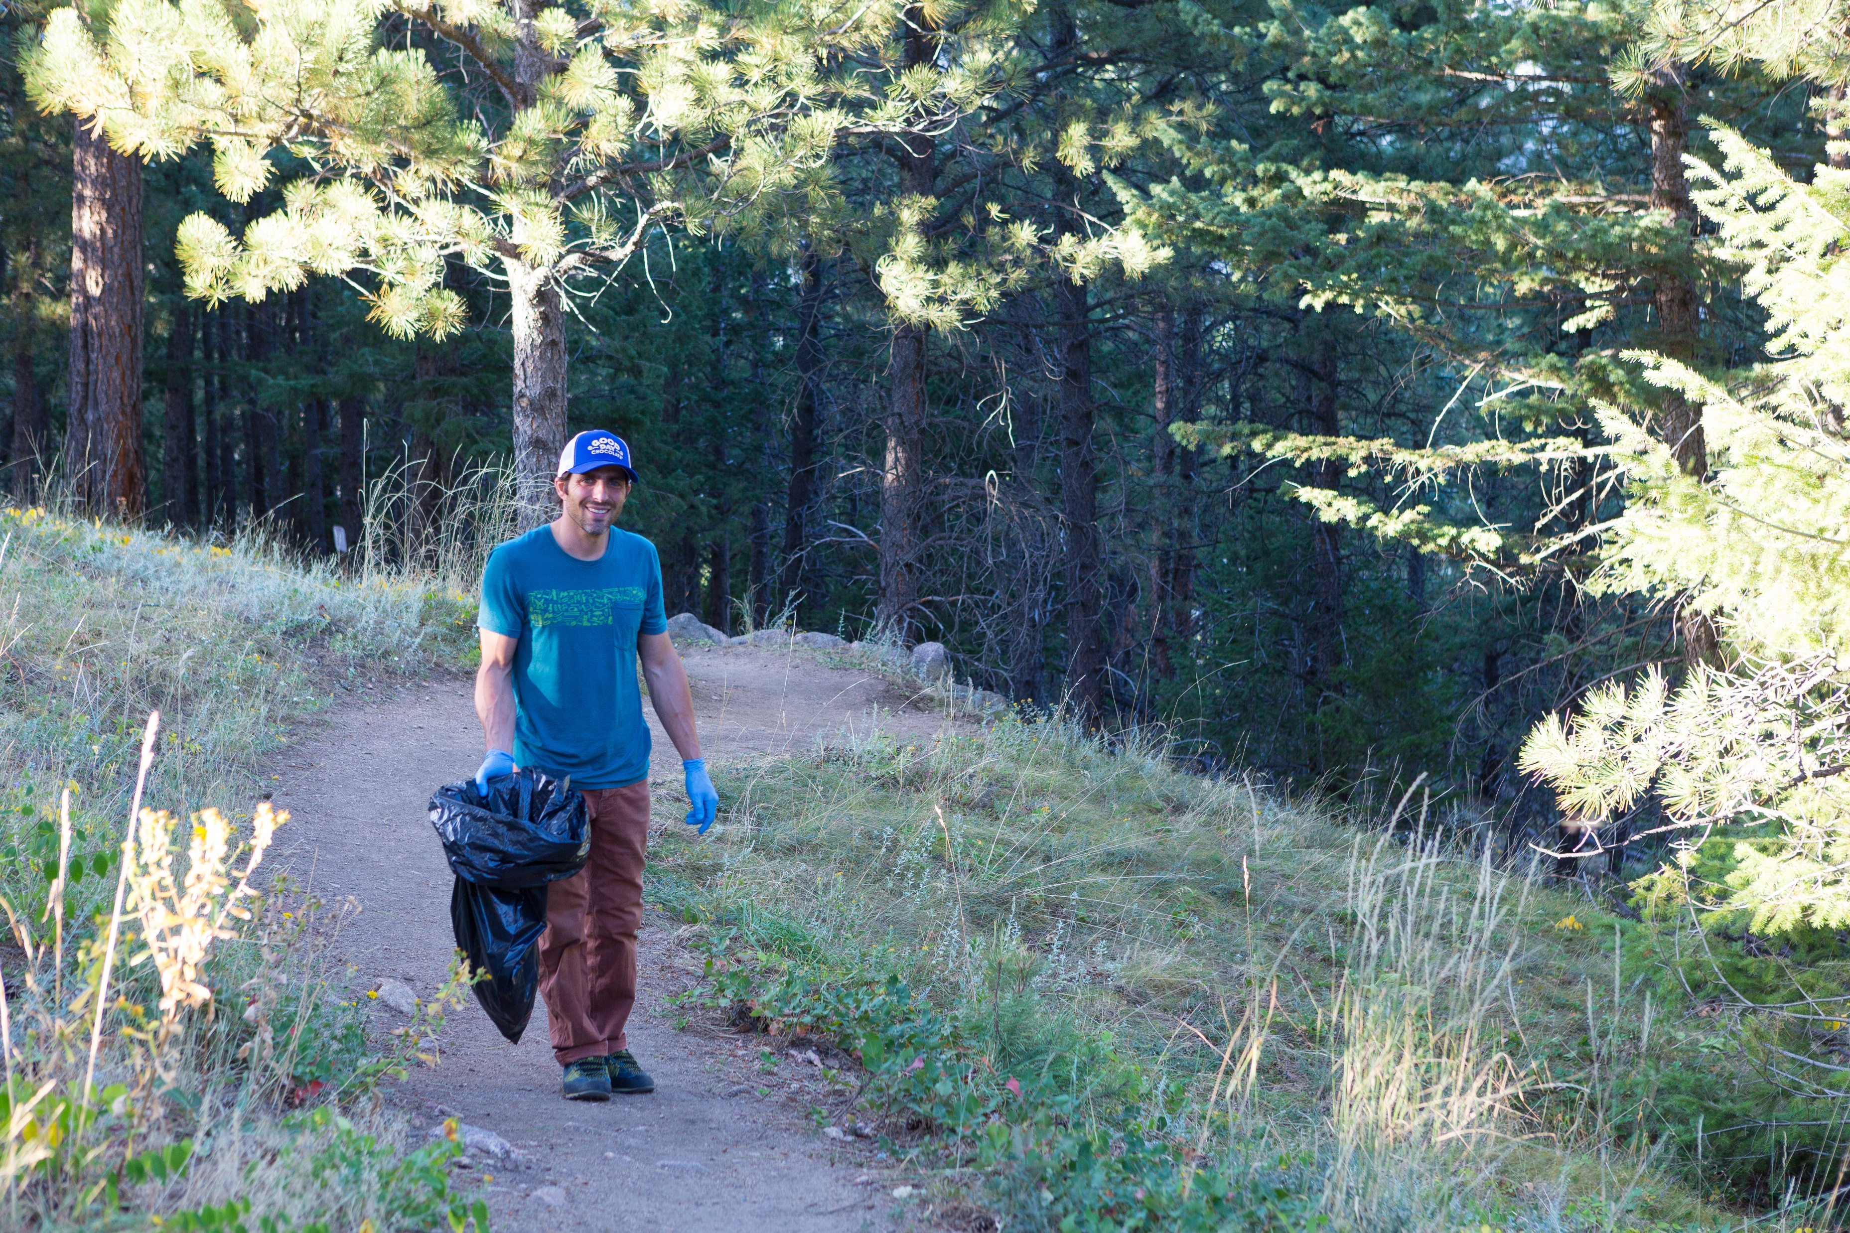
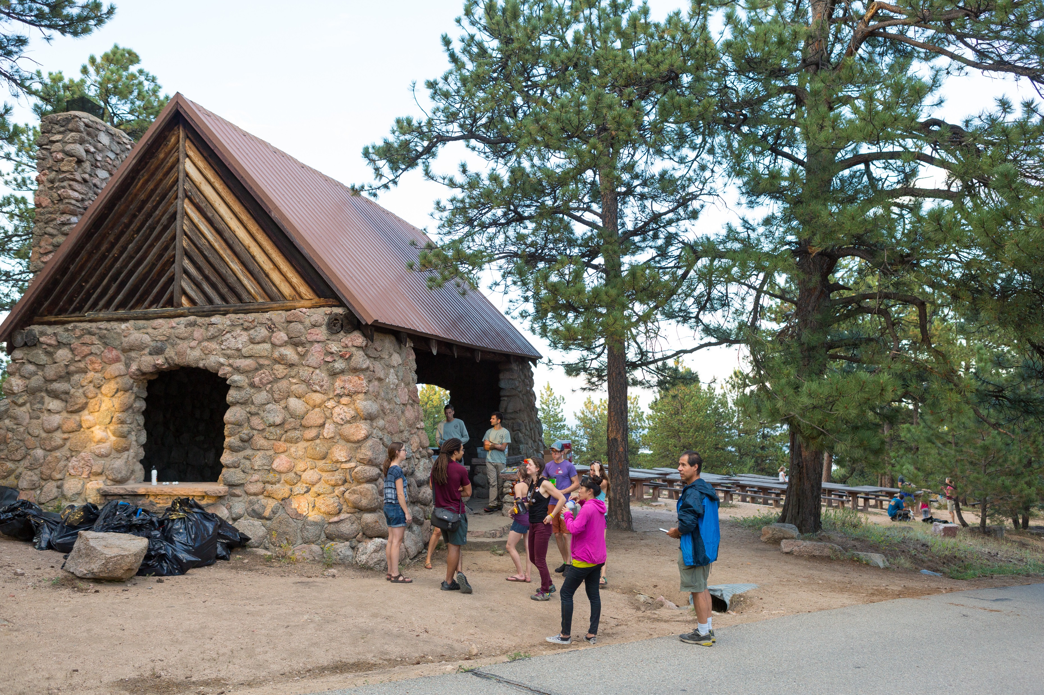
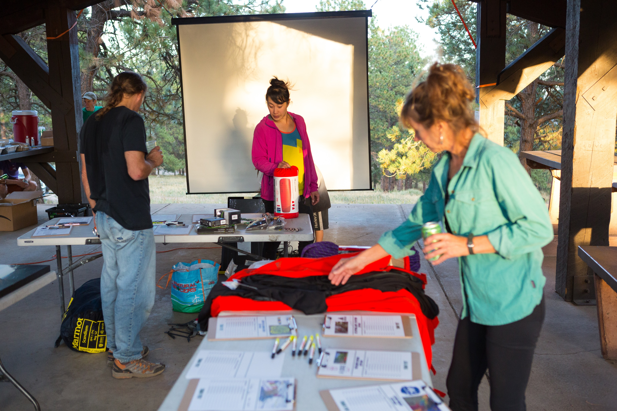
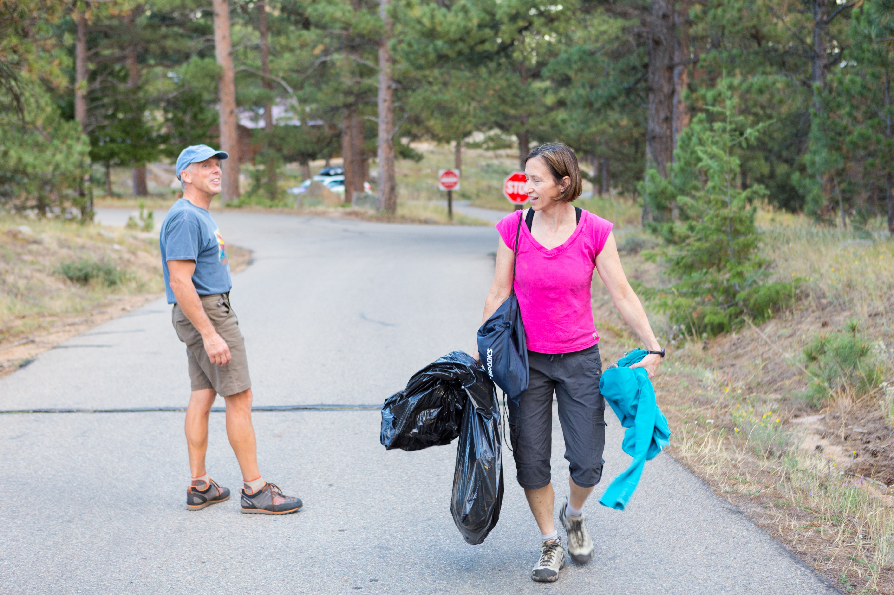
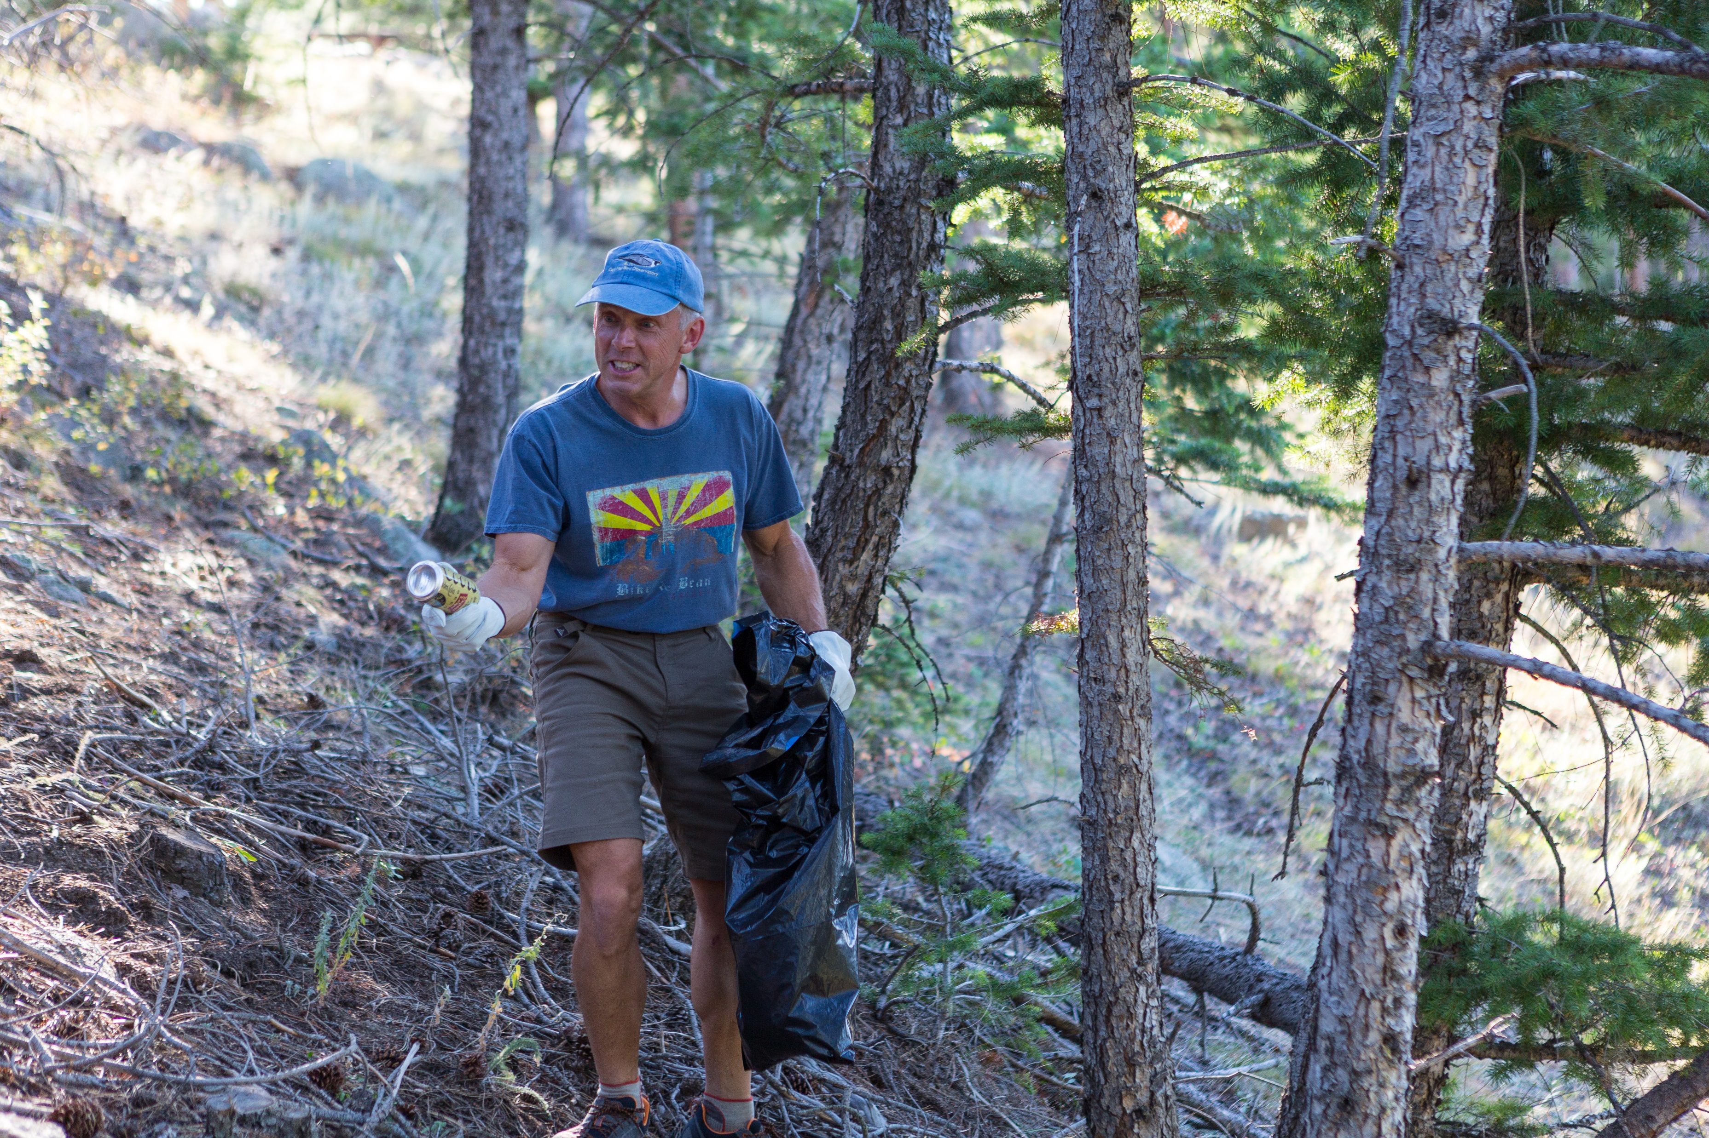
Annual Trash Bash: FCC/OSMP

Slide 9
Annual Trash Bash: FCC/OSMP
Goals: create simple map
Challenges: capture & source data; convert to web application
Successes: QR to web map, worked with graphic artist for final product
Next Steps: maintain database, develop story map, increase functional aspects of web map
Notes:
90% - Value of GIS mapping to clean-up efforts, ability to simply communicate using map,
working with Graphic Artist
10% - creating a web app, configuring pop-ups, adding QR code

Slide 10
Questions?
Doug Haller; GISCO Quarterly Meeting, October 20, 2017,Golden, CO
Contact Information: cell: 303.818.3230; Email: haller8a@gmail.com; URL:www.baselinedataanalysis.com

